Slide 1

Accessing Web Knowledge with Natural Language Interface
Wenhu Chen (wenhuchen@ucsb.edu)
Committee: William Wang, Xifeng Yan and Ambuj Singh

Slide 2
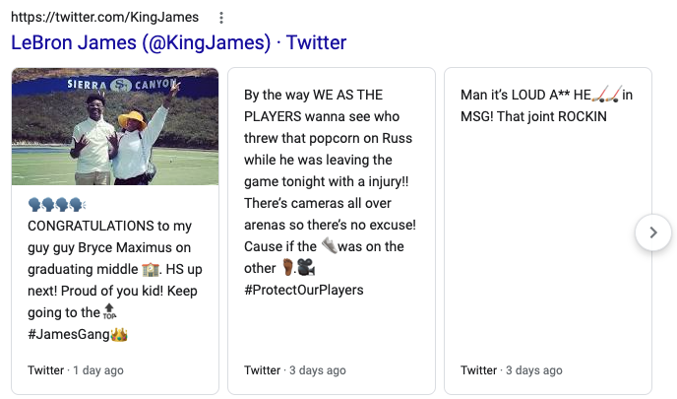
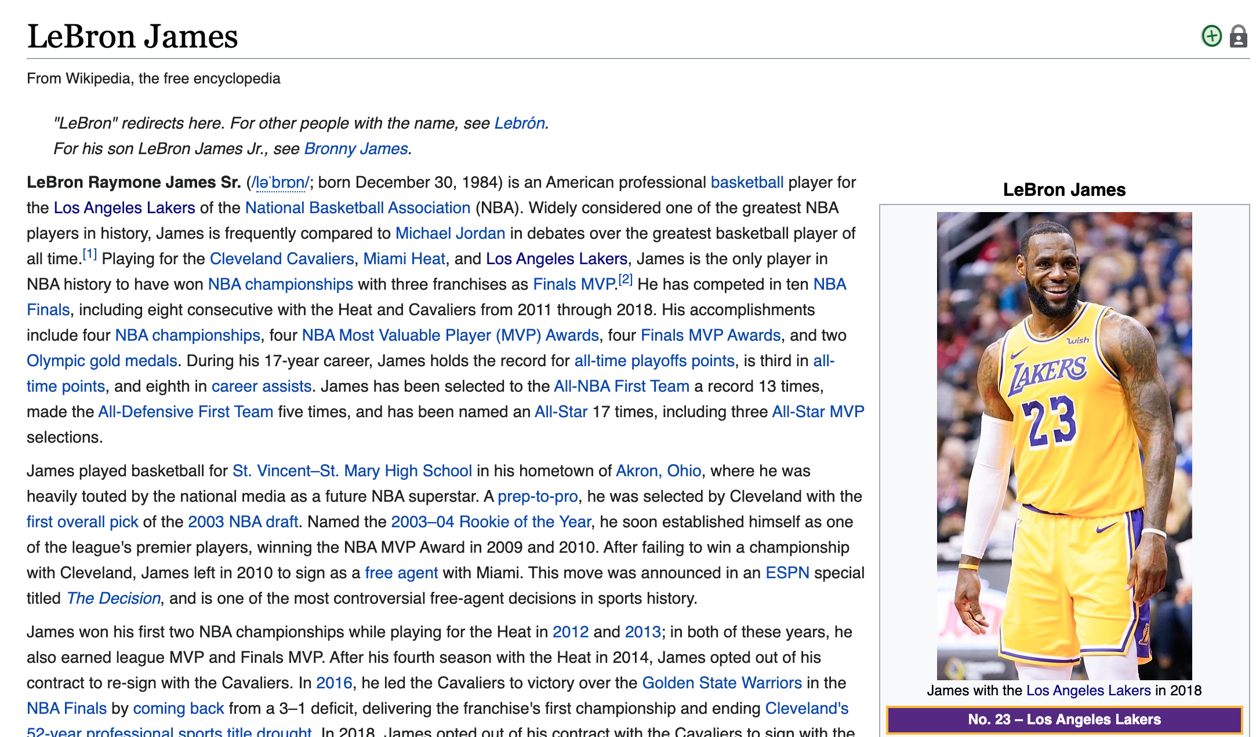


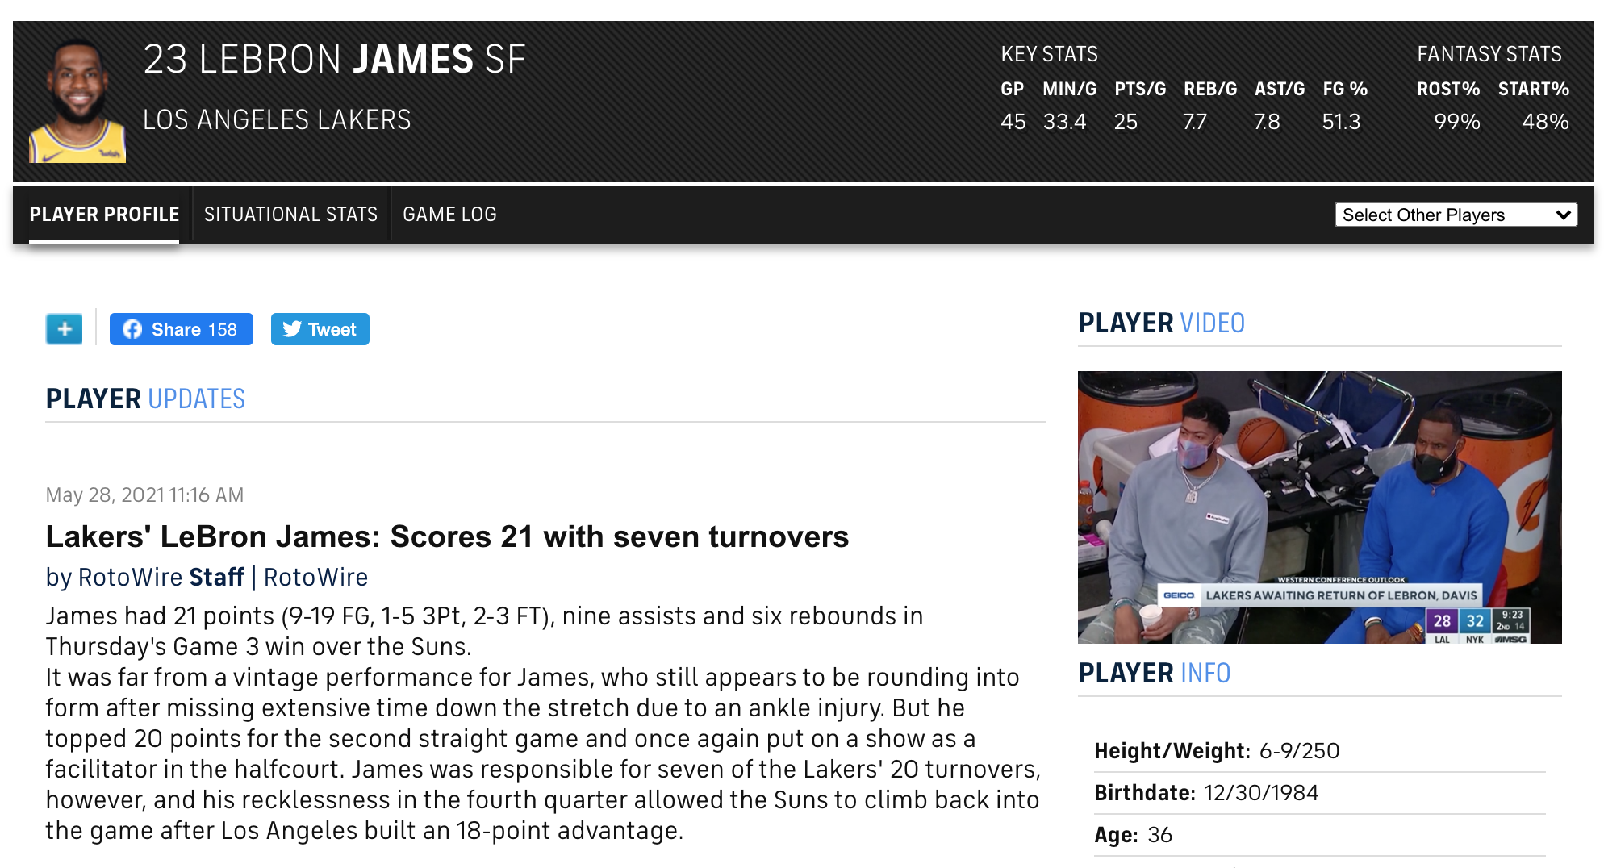
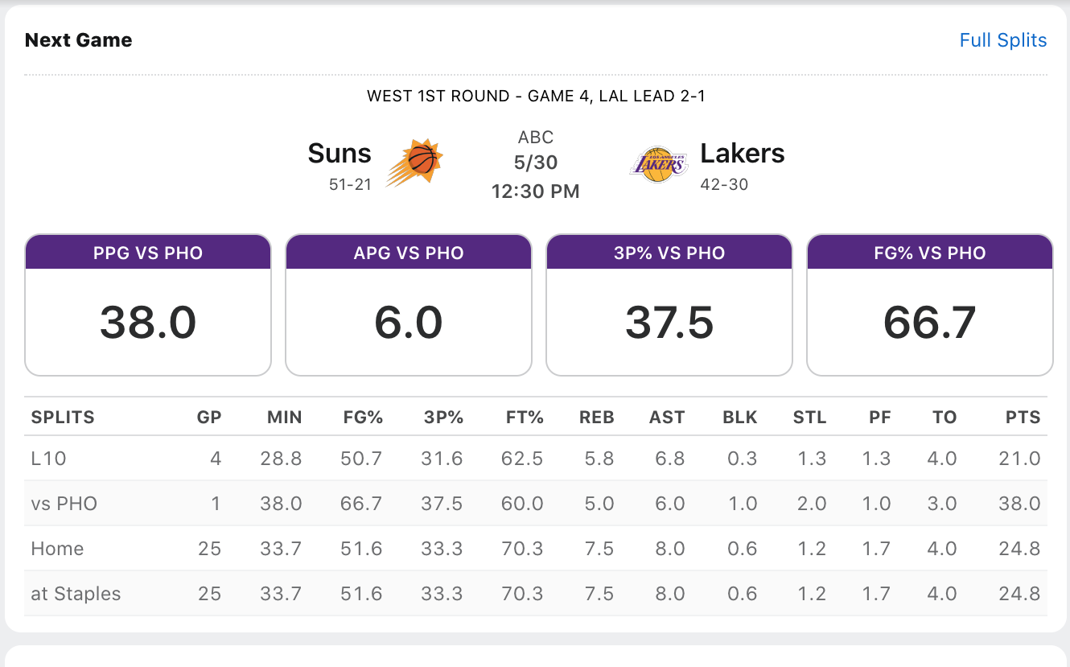






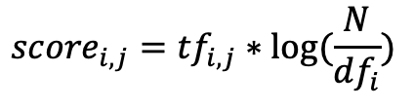
Traditional Web Interface
Keyword: Lebron James
Keyword-Word Interface
$${score}_{i, j}={tf}_{i,j}∗log⁡(\frac{N}{{df}_{i}})$$
Diverse & Massive Web Knowledge
Notes:
With the information explosion on the internet, there are zillions of knowledge facts distributed on the Web. As a human, it’s very challenging to process information in this order. Therefore, different interfaces have been invented to help us access the Web knowledge. Instead of using programming language to communicate with the interface, is there chance that we could use natural language to communicate with these interfaces. That\s the topic I’m working on throughout my Phd career.

Slide 3


Restrictions of Traditional Interface
- Lebron James
- Average points per game
- COVID-19 NBA season
Term-based Query: The interface cannot handle complicated query.
Too many Pages!
I can’t read them all.
Coarse-grained Response: Large collection of web pages are provided.

Slide 4
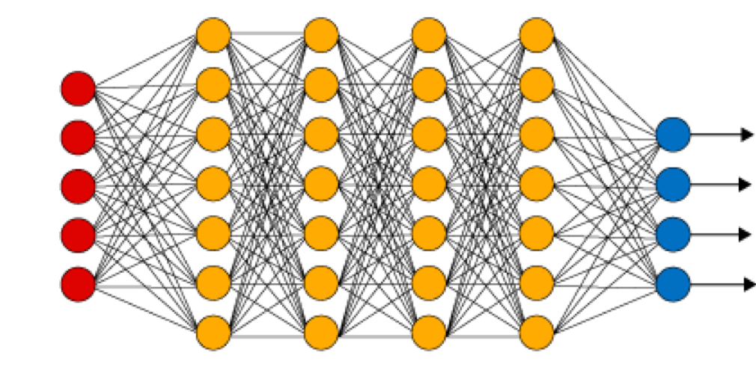
Natural Language Interface
What is the average points per game of Lebron in the last NBA season?
Lebron James obtained an average of 25.3 points in L.A. Lakers during 2019-20 season.
Natural Language Interface
Diverse & Massive Web Knowledge
Notes:
Here is an example, if we are interested in accessing information about Lebron James on the internet and ask the following question of “What is the average points per game …”, We hope to receive the information from our smart device like phones, tablets, etc. In order to embed such service into our edge device, we need to build natural language interface.

Slide 5
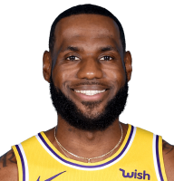
Natural Language Understanding
What is the average points per game of Lebron in the last NBA season?
Natural Language Interface
Position | Small forward
Born | 1984, Ohio
Lebron James Career Statistics
Year | Team | PPG
2016-2017 | Cleveland | 26.4
2017-2018 | Cleveland | 27.5
2018–2019 | L.A. Lakers | 27.4
2019–2020 | L.A. Lakers | 25.3
LeBron James is an American professional basketball
player for the Los Angeles Lakers of the National Basketball Association (NBA).
SELECT(PPG) FROM “Lebron James Career Statistics” WHERE Year=“2019–20”;
Supporting Evidence
Name: Lebron James, Team: LA Lakers, PPG: 25.3, Season: 2019-20
Notes:
In order to build a virtual assistant, the model requires knowledge-grounded understanding, i.e. the model needs to understand the semantics of the given natural language input. For example, the model needs to reason over the world knowledge to understand Lebron means Lebron James and last NBA season means 2019-2020 NBA season.

Slide 6

Natural Language Generation
Lebron James obtained an average of 25.3 points in L.A. Lakers during 2019-20 season.
Natural Language Interface
S
NP
VP
Lebron James
V
NP
PP
obtained
during 2019-20 season
NP
PP
an average of 25.3 points
in LA Lakers
Grounded Generation
Name: Lebron James, Team: LA Lakers, PPG: 25.3, Season: 2019-20
Notes:
Then the model needs to ground on the supporting knowledge to generate natural language response to generate natural language sentences.

Slide 7
My PhD Contributions
Natural Language Interface
Natural Language Understanding
Question Answering
Fact Verification
QA over
Heterogeneous Data
[EMNLP20, ICLR21]
QA over Visual Data
[WACV21]
Verification
over Table
[ICLR20]
Verification
over Text
[ACL21]
Natural Language Generation
Data-to-Text
Visual Captioning
KB-to-Text
Table-to-Text
[ACL20,EMNLP20
Dialog Generation
[ACL19]
Image Captioning
[ACL18]
Video
Captioning
[CVPR18]

Slide 8



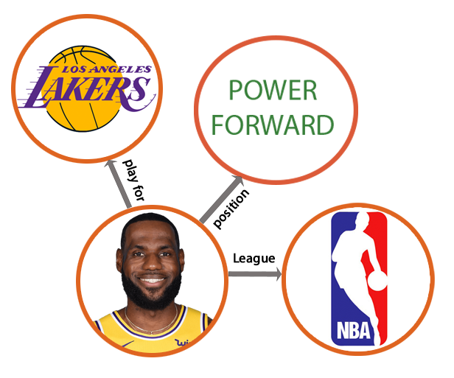

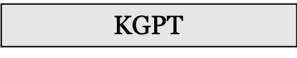
Talk Outline
Multi-Hop Question Answering over Heterogeneous Data
Retriever
Answer
[Chen et al ICLR21]
Reader
Multi-Hop Question Answering over Visual Data
compare
right
left
[Chen et al WACV21]
locate
locate
Pre-trained Text Generation over Structured Data
KGPT
[Chen et al. EMNLP20]
Notes:
Now let’s move on to the second section.

Slide 9


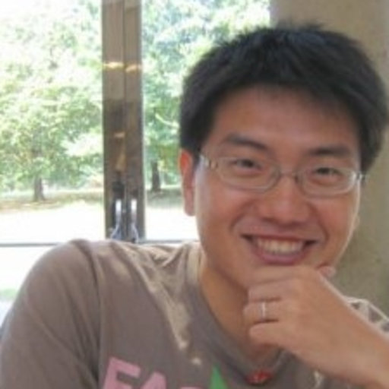
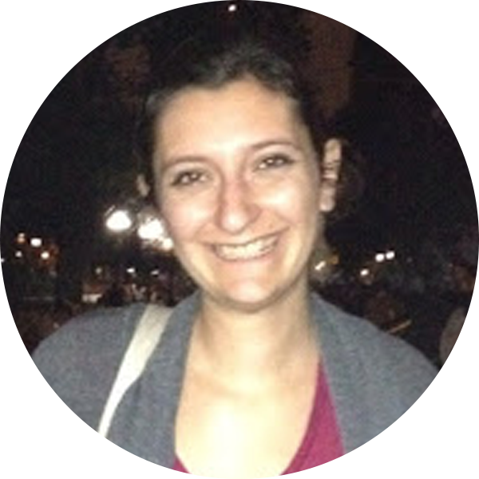
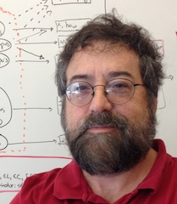

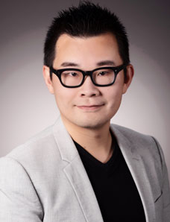
Talk Outline
What is the home stadium of Lebron James during NBA season suspended by COVID?
Multi-Hop Question Answering over Heterogeneous Data
Documents
Lists
Tables
Un-structured
Structured
6,216,701 pages
Notes:
Now let’s move on to the second section.

Slide 10
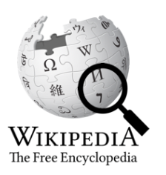
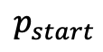
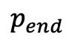
Background: Single-Hop Question Answering
Which NBA season was suspended by COVID?
$$p_{start}$$
$$p_{end}$$
IR
Google BERT
2019–20
The 2019–20 NBA season was the 74th ... The regular season
began on October 22, 2019, and originally …. However, the season was suspended on March 11 as a result of the COVID-19 pandemic.
Notes:
Let me first go over the existing open question answering paradigm, which was mainly focused on only using the unstructured textual data. In this setting, a retriever scans over the web to select the most relevant passage as the support evidence. A reading comprehension model is used to predict the answer span.

Slide 11
Complex Multi-Hop Question Answering
What is the home stadium of Lebron James in the NBA season suspended by COVID?
List of NBA Teams of Lebron James
1
The 2019–20 NBA season was the 74th ... The regular season
began on October 22, 2019, and originally …. However, the season was suspended on March 11 as a result of the COVID-19 pandemic.
2
Year | Team
2012-11 | Miami
2013-14 | Miami
2014-15 | Cleveland
2015-16 | Cleveland
2016-17 | Cleveland
2017-18 | Cleveland
2018–19 | L.A. Lakers
2019–20 | L.A. Lakers
3
The Los Angeles Lakers are an professional basketball team based in Los Angeles. The Lakers compete in the NBA as a member of the league's Western Conference Pacific Division. The Lakers play their home games at Staples Center
Notes:
However, the question might be deemed unanswerable by only looking into a few passages. If we go a extra mile to retrieve tables from the web, we are actually able to answer this given question.

Slide 12



Heterogeneous Information Integration
What is the home stadium of Lebron James in the NBA season suspended by COVID?
Unified QA Model
retrieve
integrate
Answer: 25.3
Challenges
Dataset
Integration
Notes:
The goal of this section is to design a unified reasoning model, which is not only able to understand structured and unstructured data from the web but also able to integrate these two forms of data. Datasets and Efficiency are big issues.

Slide 13


OTT-QA (Open-Table-Text) Dataset
Lebron James Career Statistics
NBA 2018-19 Season
Year | Team | BPG | PPG
2015–16 | Cleveland | .6 | 25.3
2016–17 | Cleveland | .6 | 26.4
2017–18 | Cleveland | .9 | 27.5
2018–19 | L.A. Lakers | .6 | 27.4
2019–20 | L.A. Lakers | .5 | 25.3
NBA 2019-20 Season
Cleveland Cavaliers
L.A. Lakers
NBA 2017-18 Season
(Q, A)
Annotation
Quality Control
OTT-QA
Size: 45K
Model
Human
Notes:
We collected our own dataset called OTT-QA, which consists of table crawling, passage linking. We provide both tables and text to the crowd-workers to let them write Q-A pairs, then we perform model-based and human-based quality control to make sure the questions require information integration and human-based grammaticality and fluency checking. Finally, we harvest a dataset consisting of 45K QA pairs.

Slide 14

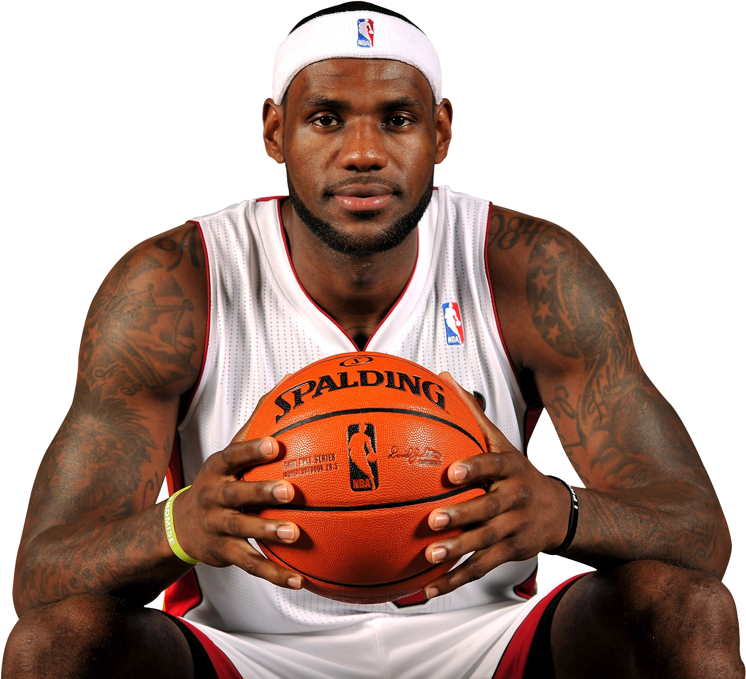


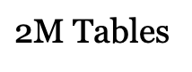
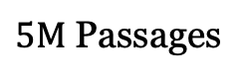
Retriever-Reader Framework
Q: What is the home stadium of Lebron James in the NBA season suspended by COVID?
Top-K
Retriever
Reader
Answer
Wikipedia Candidate Pool
$5M$ Passages
$\text{2}\text{M}$ Tables

Slide 15
Multi-Hop Retriever [Baseline]
Q: What is the home stadium of Lebron James in the NBA season suspended by COVID?
BERT Encoder
The 2019–20 NBA season was.... Suspended by COVID-19 pandemic.
1
BERT Encoder
$5M$ Passages
$\text{2}\text{M}$ Tables
Notes:
To learn

Slide 16
Multi-Hop Retriever [Baseline]
Q: What is the home stadium of Lebron James in the NBA season suspended by COVID?
BERT Encoder
Year | Team
2012-11 | Miami
2013-14 | Miami
2019-20 | LA Lakers
2
BERT Encoder
$5M$ Passages
$\text{2}\text{M}$ Tables
Notes:
To learn

Slide 17
Multi-Hop Retriever [Baseline]
Q: What is the home stadium of Lebron James in the NBA season suspended by COVID?
BERT Encoder
3
The Lakers play their home games at Staples Center
BERT Encoder
$5M$ Passages
$\text{2}\text{M}$ Tables
Notes:
To learn

Slide 18

Single-Hop Retriever [Ours]
Q: What is the home stadium of Lebron James in the NBA season suspended by COVID?
BERT Encoder
The Lakers play their home games at Staples Center
Graph Encoder
Teams
Coaches
2019-20
Frank
Stadium
COVD
Suspension
Staples

Slide 19


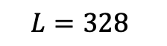
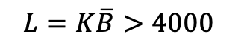
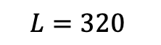
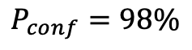
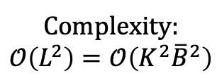
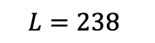
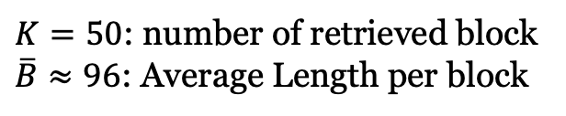
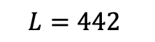
Full-Attention Reader [Baseline]
$$p_{start}$$
$$p_{end}$$
Google BERT
Complexity:
$$𝒪\left(L^{2}\right)=𝒪\left(K^{2}{\overline{B}}^{2}\right)$$
Slow! Memory Overflow!
$$P_{conf}=98\%$$
$$L=328$$
$$L=442$$
$$L=238$$
$$L=320$$
$$L=K\overline{B}>4000$$
Global context fails to be modeled, local optimum!
$K=50$: number of retrieved block
$\overline{B}≈96$: Average Length per block
Notes:
After we retrieve the top-K candidate blocks, we need to feed them to the neural extractive readers to extract the answer span from the retrieved blocks. However, since we are dealing with significant amount of blocks. If we concatenate all the document, the input sequence length can easily go beyond 4000, which is almost impossible for the reader to handle given its quadratic time complexity. Therefore, the existing frameworks usually decompose the long sequence into a set of smaller groups where each group contains less than 500 tokens. These smaller groups will be fed to the reader in parallel to extract the answer, the one with highest confidence will be used as the final prediction. This framework fails to model global context due to the lack of interaction between different groups, the prediction is basically local optimum.

Slide 20
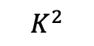
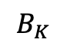
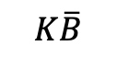
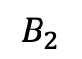
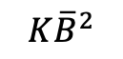
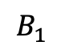
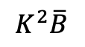
Global-Local Sparse Attention
Local-Global
$$K^{2}\overline{B}$$
Global-Global
$$K^{2}$$
Global-Local
$$K\overline{B}$$
Local-Local
$$K{\overline{B}}^{2}$$
K Global
$$B_{1}$$
$$B_{2}$$
$$B_{K}$$
Complexity: $𝒪\left(K{\overline{B}}^{2}+K\overline{B}+ K^{2}+K^{2}\overline{B}\right) \sim 𝒪\left(K{\overline{B}}^{2}\right)$
Notes:
We use the global-local sparse attention mechanism to decrease the complexity to KxB^2.

Slide 21
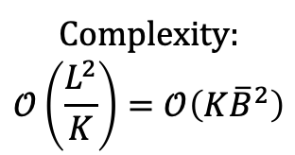
Sparse-Attention Reader [Our Model]
$$p_{start}$$
$$p_{end}$$
Complexity:
$$𝒪\left(\frac{L^{2}}{K}\right)=𝒪\left(K{\overline{B}}^{2}\right)$$
Sparse-Attention
Fast! Memory Efficient!
$$L=K\overline{B}>4000$$
Global context is modeled, global optimum
$K=50$: number of retrieved block
$\overline{B}≈96$: Average Length per block
Notes:
We use the sparse-attention mechanism, we can directly feed all the retrieved blocks to the reader without worrying about the memory overflow and speed. This framework has the advantage that the global context is modeled, the prediction is basically global optimum.

Slide 22

Experimental Results
OTT-QA Test Experimental Results (Accuracy)
27.2%
16.9%
13.4%
9.9%
9.8%
7.2%
4.6%
BM25
Text
BM25
Table
BM25
Hybrid
Multi-Hop
BERT
Single-Hop
BERT
Multi-Hop
Sparse-Att
Single-Hop
Sparse-Att
BM25 Baselines
Xiong et al. 2020
Ours
Single-Hop Retriever: ~8x faster than Multi-Hop Retriever
Sparse-Attention Reader: ~2x faster than BERT Reader
Notes:
We evaluate our model Single-R and Sparse-R on OTT-QA test split and our model is able to achieve significant performance gain. Besides, our model runs much faster than the baseline systems.

Slide 23
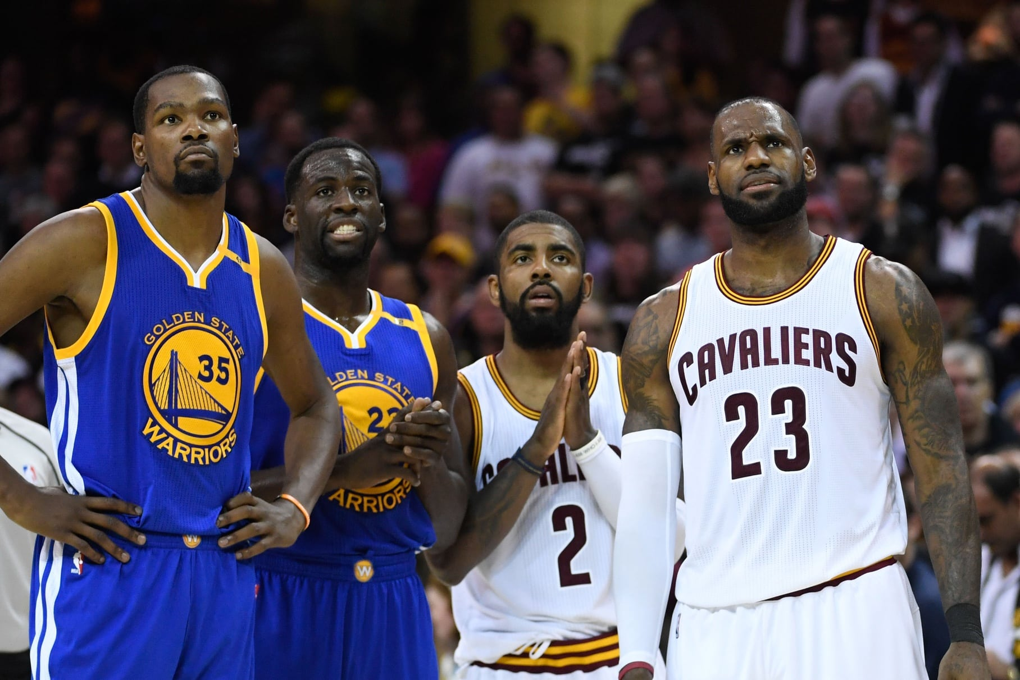

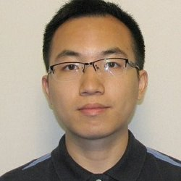
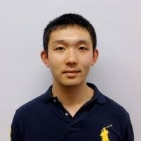
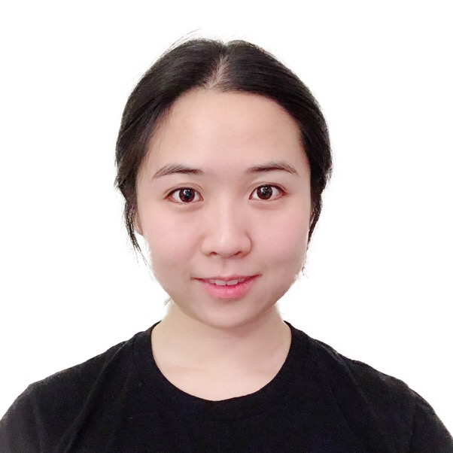
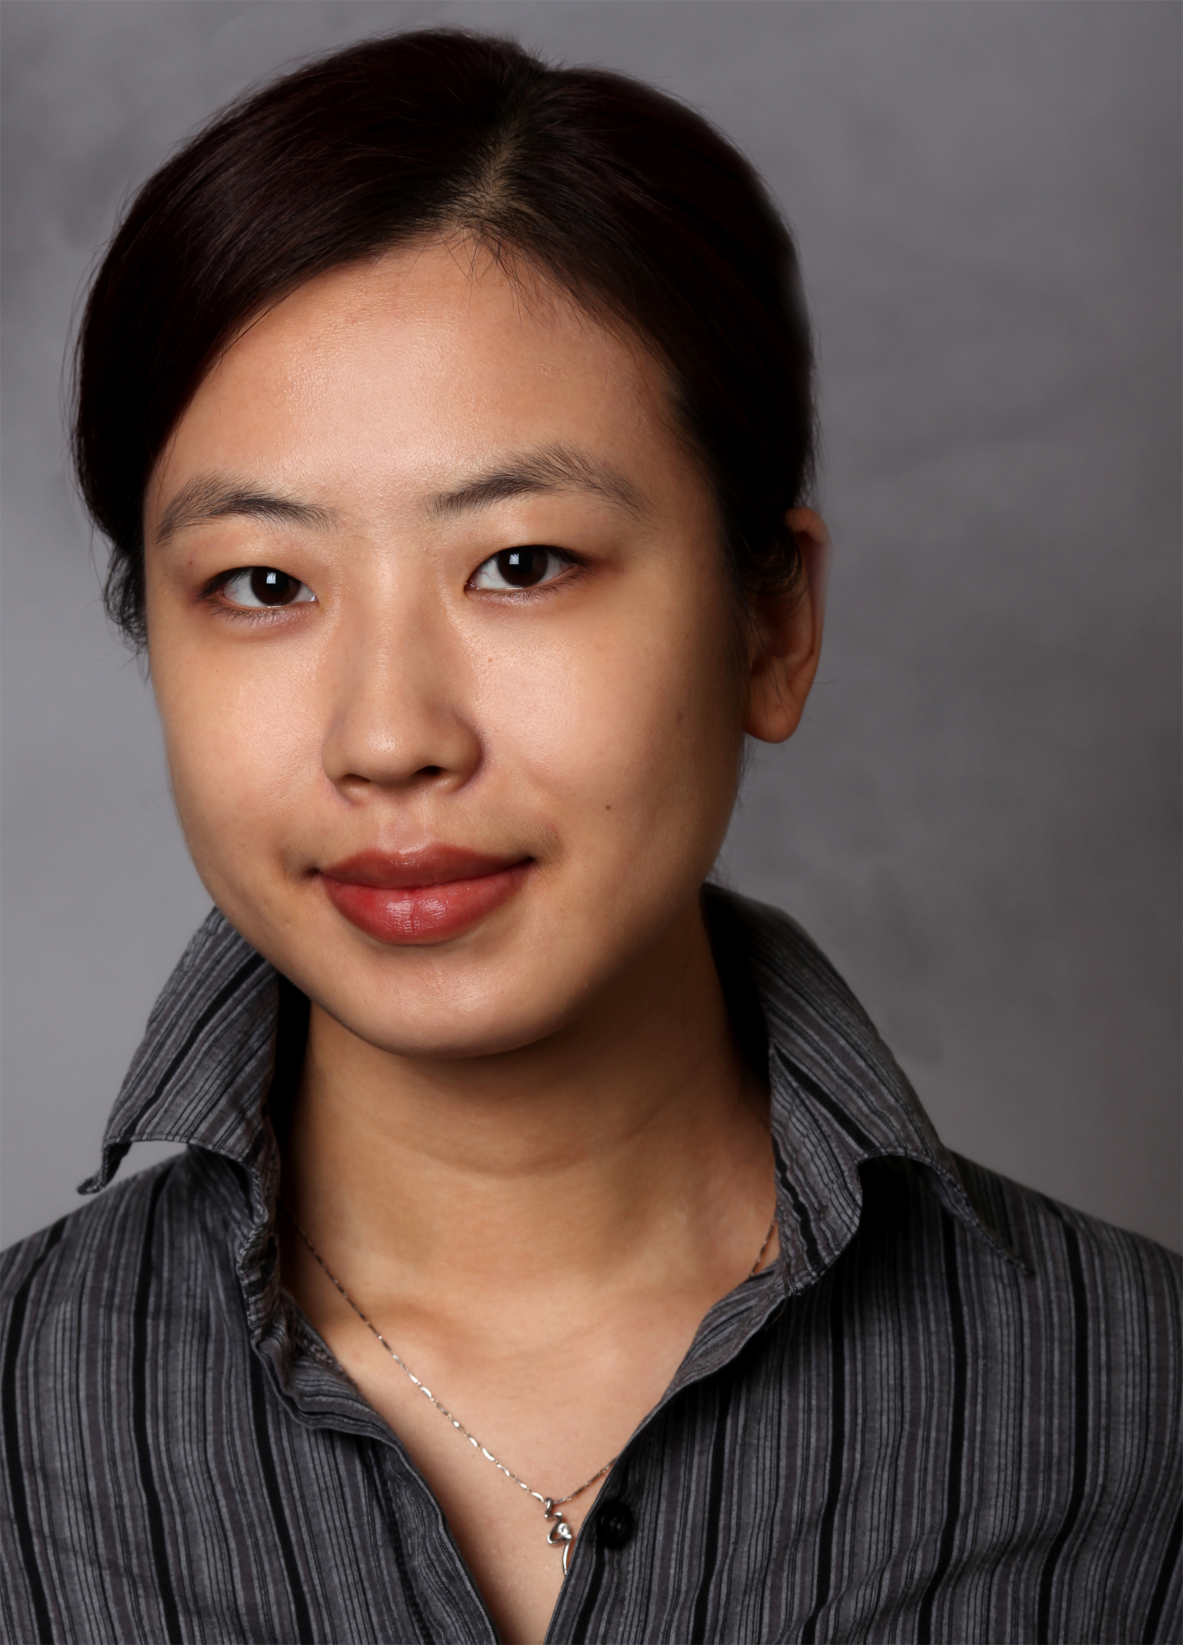
Talk Outline
Which person is taller, the left most or the right most player?
Multi-Hop Question Answering over Visual Data
AI System
Left
Notes:
Now let’s move on to the second section.

Slide 24

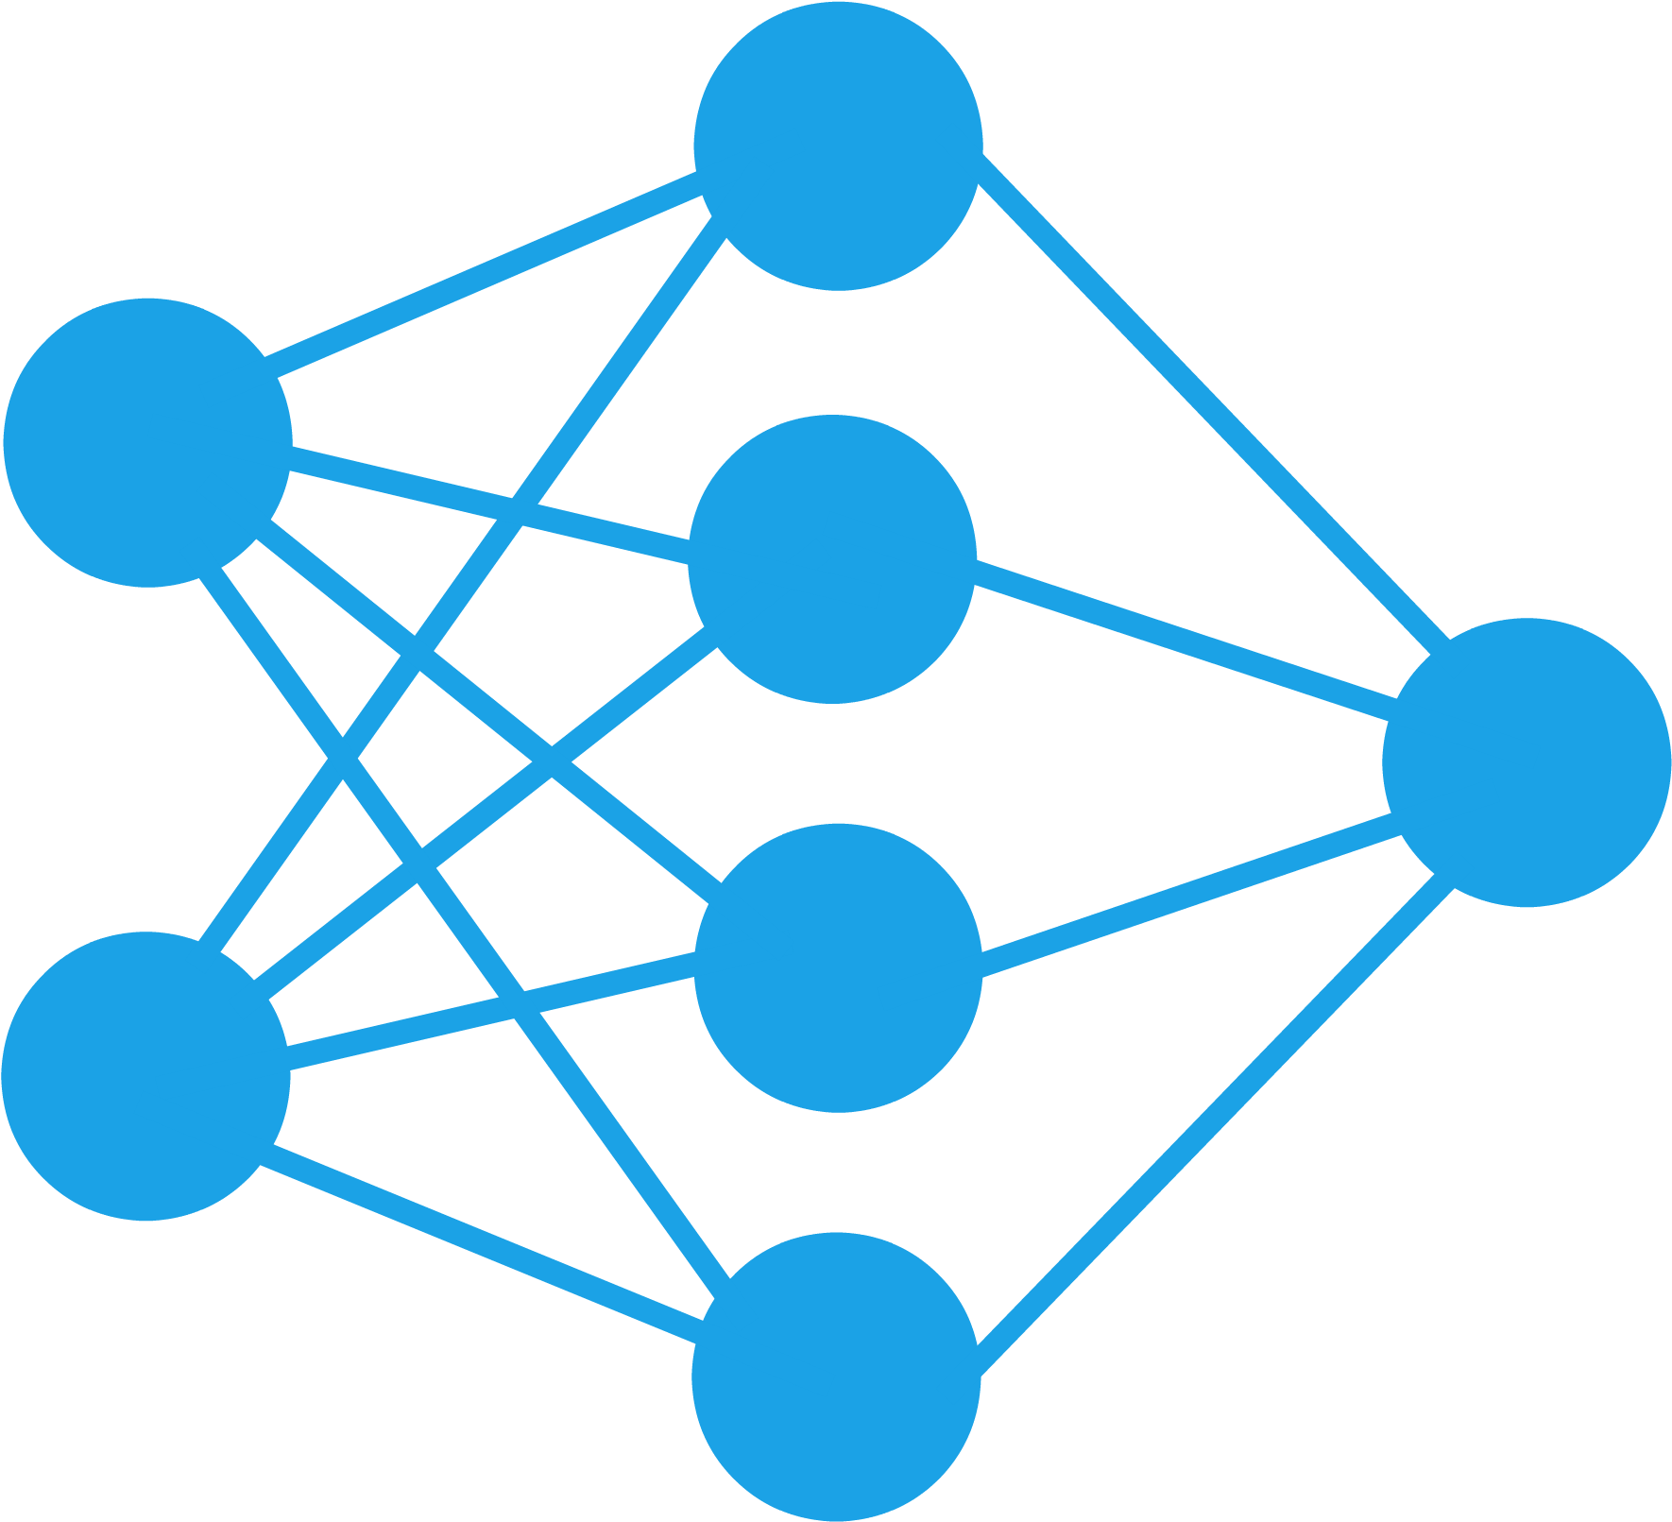

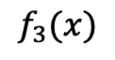
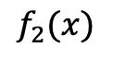
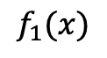
Background: Neural Module Networks
Function Inventory
sub-task
input
module
output
$$f_{1}(x)$$
Move(Right)
$$f_{2}(x)$$
Move(Left)
$$f_{3}(x)$$
Locate(Yellow)

Slide 25
Background: Neural Module Networks
Q1
Q2
Q3
Qn
Parser
Move
(Right)
Locate
(Yellow)
Color
Locate
(Yellow)
Move
(Left)
Color
Filter
(Yellow)
Greater
Move
(Right)
Locate
(Yellow)
Compare
Filter
(Yellow)
Locate
(Yellow)
Locate
(Yellow)
Filter
(Yellow)
Function Inventory
Move
(Right)
Locate
(Yellow)
Locate
(Yellow)
Move
(Left)
Color
Compare
…
Filter
(Yellow)

Slide 26
Pros: Explainability
Yellow
Locate(Left)
Locate(Top)
Color
Parser
What’s the color of the object in the top left?

Slide 27

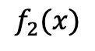
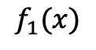
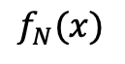
Cons: Scalability & Generalization
Scalability Issue
Generalization Issue
Move(Right)
$$f_{1}(x)$$
Move(Right)
Training
Move(Left)
$$f_{2}(x)$$
Locate(Left)
Locate(Yellow)
$$f_{3}(x)$$
Locate(Right)
Testing
Unseen
Material(Soft)
$$f_{N}(x)$$
Move(Left)
What if we have 50 functions?
Can we infer the new function?

Slide 28

Solution: Meta Learning
Generalization
Scalability
Meta-Learning
- Instead of learning a function $f_{i}(x)$ for each task $t_{i}$.
- Can we learn a meta-function $g(t)$, which takes a task $t_{i}$to generate $f_{i}(x)$?

Slide 29

Meta Module (Concept)
Action: Move
Direction: Left
f(x)
t=Task Description
Meta Function g(t)

Slide 30
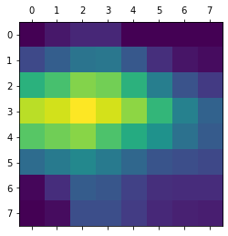
Meta Module (Implementation)
Meta Module
Instance Module
Output Feature
g(t)
f(x): Move(Left)
Transformer
t: Embed
Attention
Action: Move
Object: Left
Input Feature

Slide 31
Meta Module Composition
Left
Compare(Height)
Compare(Height)
g(t)
Move(Left)
Move(Left)
f(x)
Locate(Right)
Locate(Right)
Which person is taller, the left most or the right most player?

Slide 32

Instance Module Supervision
How can we
ensure it’s
executing
correctly?
Supervise
Locate(Right)
Locate(Right)
Symbolic Executor
Image with rich annotated

Slide 33
Training (Module & QA Supervision)
Loss
KL-Divergence
Cross-Entroy
Choose(Tall)
Move(Left)
Locate(Right)
Locate(Right)
Q
Image

Slide 34

Scalability & Generalization
1
Move(Right)
Move(Right)
Training
2
Move(Left)
Locate(Left)
3
Locate(Yellow)
extrapolate
N
Material(Soft)
Unseen
Locate(Right)
g(t)
Embedding
Scalability
Generalization

Slide 35
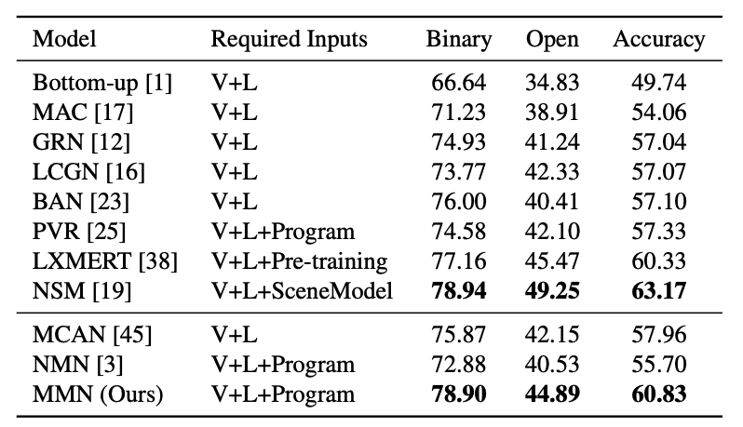
Experimental Results
Name | #Question | #Function | #Images | #Types
GQA | 1M | 38 | 140K | 2-Hop/3-Hop/4-Hop

Slide 36
Zero-Shot Generalization Experiments
Training Tasks
Unseen Tasks
Verify(Name); Verify(Location)
Choose(Shape); Choose(Location)
Filter(Shape); Relate(Location)
Choose(Shape); Filter(Name)
Generalize
Verify(Shape)
Relate(Name)
Filter(Location)
Choose(Name)
Execution Accuracy on GQA per Function
77%
61%
62%
50%
50%
50%
23%
5%
Verify(Shape)
Relate(Name)
Filter(Location)
Choose(name)
Neural Module Network
Meta Module Network

Slide 37
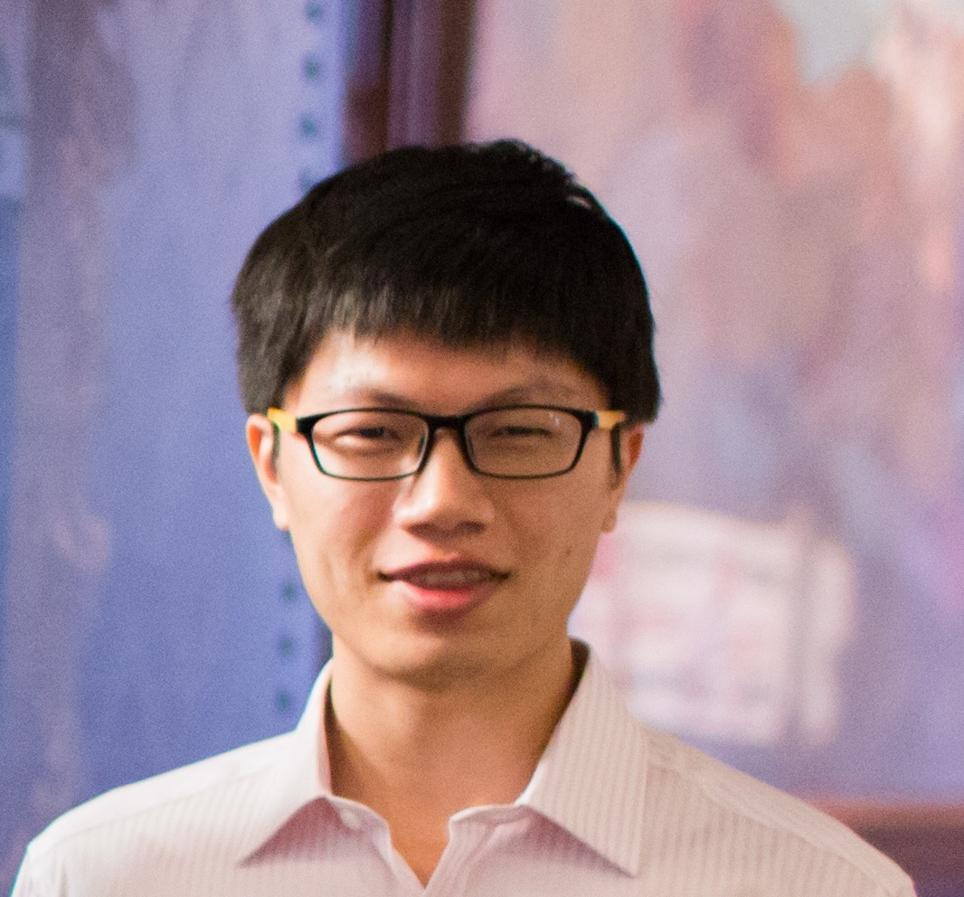

Talk Outline
Lebron James plays as power forward at L.A. Lakers.
Pre-trained Text Generation over Structured Data
AI System
Notes:
Now let’s move on to the second section.

Slide 38






Knowledge-grounded Generation Datasets
Knowledge
Text
Datasets
Murakami et al. 2017
Aok et al. 2019
chart
report
Liang et al. 2013
Dušek et al. 2018
pair
dialog
Gardent et al. 2017
Chen et al. 2020
Radev et al. 2020
triple
description
Wen et al. 2013
Remi et al. 2016
Chen et al. 2020
Parikh et al. 2020
table
biography
Notes:
There has been a wide spectrum of dataset working on such knowledge-grounded generation datasets, these datasets use different structured knowledge as the input and aim to generate different types of text.

Slide 39



Generative Pretrained Transformer (GPT-2)
Lebron James plays as power forward at L.A. Lakers.
Predict
OpenAI GPT-2
Internalize
World Knowledge
~1B Parameters
Input
Lebron James plays as _ _ _ _ _ _.
Sample
Web Text
Notes:
The state-of-the-art model for addressing these wide spectrum of dataset is called GPT-2, which was pre-trained using all the text from the web. For example, a random sentence is sampled from the web, we feed the prefix of the sentence to the model to let it autoregressively generate the original sentence. What this model does is to memorize/internalize the world world knowledge into its 1B parameters.

Slide 40

Promise and Perils of GPT-2
Human-Written Prompt:
A train carriage containing controlled nuclear materials
was stolen in Cincinnati today. Its whereabouts are unknown.
System Completion:
The incident occurred on the downtown train line, which runs from Covington and Ashland stations.
In an email to Ohio news outlets, the U.S. Department of Energy
said it is working with Federal Railroad Administration to find
the thief.
The incident occurred on the downtown train line, which runs from Covington and Ashland stations.
In an email to Ohio news outlets, the U.S. Department of Energy
said it is working with Federal Railroad Administration to find
the thief.
Hallucination
Notes:
Since GPT-2 has been proposed, it has attracted lots of attention from the community. Here we steal an example from the OpenAI blog, …. . At first glance, the machine generated story looks so real that you couldn’t tell whether it’s true or fake. However, if you google a little about “Cov…”, you will find that it does not exist in the world. It means that the model is really good at hallucinating non-existing facts from the world.

Slide 41
Hallucination[1]: Mis-Memorization
Prefix | Completion
Taylor Swift was born in the year of | 1859
Microsoft was founded by | John McAfee
Christmas is in the month of | October
California is located in the country of | India
Tea was invented in | Russia
100 frequent factual knowledge
probe
Notes:
The hallucination comes from two aspects: 1) mis-memorization, where the model has seen this fact before but cannot memorize it due to the limitation of its parameter capability. …

Slide 42

Hallucination[2]: Stale-Memorization
2017 Corpus
2021
The final MVP Lebron James
led his team Cleveland Cavaliers with a strong comeback ….
Lebron James led his team Cleveland Cavaliers to win the 2020 NBA championship by defeating Miami Heat.
Lebron James was drafted as the first place by Cleveland Cavaliers.
Lebron James brought the champion to Cleveland Cavaliers.
Notes:
Another type of hallucination is stale memorization, where the model was trained on a previous web dump, but lots of the knowledge has changed since then. The model will memorize these stale knowledge, thus causing hallucination consequently.

Slide 43



Internalizing Linguistic & Factual Knowledge
Implicit Linguistic Knowledge
Explicit Factual Knowledge
A ___ has fur
Internalize
Internalize
Notes:
When we look closer to the GPT-2, we found that it’s trying to understand two types of knowledge. One is the implicit linguistic knowledge, like how to compose a natural sentence with the given words. The other part is the explicit factual knowledge, like Bill Gates founded MS, etc. The model aims to internalize both types of knowledge.

Slide 44
Externalizing Factual Knowledge
Implicit Linguistic Knowledge
Explicit Factual Knowledge
A ___ has fur
Internalize
Externalize
Notes:
Since the factual knowledge is infinite and non-static, it’s challenging for the model to internalize them. Therefore, I propose to externalize this part of knowledge.

Slide 45

KGPT (Conditional) Pre-training
Lebron James plays as power forward at L.A. Lakers.
Predict
Graph
Network
KGPT
Ground
Encode
Align
KGPT (100M Parameters)
Input
Lebron James plays as _ _ _ _ _ _.
Sample
Notes:
We modify the pre-training of GPT-2 and propose KGPT using conditional pre-training. We still use the web text as the input to let the model learn how to autoregressively generate a sentence token by token. However, the big difference is that we also feed the most relevant knowledge as additional input for the model to ground on so that the model does not need to memorize all the world knowledge.

Slide 46

Pre-training Corpus Construction
Houston Rockets
Moses Malone, Hakeem Olajuwon, and James Harden have been named the NBA's Most Valuable Player while playing for the Rockets, for a total of four MVP awards.
Moses Malone
Hakeem Olajuwon
query
James Harden
Most Valuable Player
Houston Rockets
Notes:
We traverse the Wikipedia to select the sentences with hyperlinks and use these hyperlinks to request their corresponding entities in WikiData, which is a large-scale knowledge graph maintained by Wikipedia Organization.

Slide 47
Pre-training Corpus Construction
Houston Rockets
Moses Malone, Hakeem Olajuwon, and James Harden have been named the NBA's Most Valuable Player while playing for the Rockets, for a total of four MVP awards.
Moses;Harden;Hakeem
Description: American Basketball Player
Basketball
1956
Harden
award
instance of
sports
inception
awarded
MVP
Hakeem
NBA
plays for
awarded
awarded
Moses
gender
male
Power Forward
position
Filter + De-contamination
KG->Text | #Ent | #Relation | #Triple | Length | #Ent/Sent
7M | 1.8M | 1210 | 16M | 20 | 3.0
Notes:
We merge the facts from WikiData to construct the local knowledge graph. We hope that this local knowledge graph contains enough supportive evidence for the original text. We automatically construct a dataset to perform knowledge-grounded language model pre-training.

Slide 48


KGPT Pre-Training
Conditional
Pre-Training
(KG → Text) Pairs
Pre-trained Model
Notes:
We use the dataset to pre-train the transformer model for a few epochs to get the pre-trained model and we can play with this pre-trained model to compare with GPT-2.

Slide 49

Controlled Generation
Taylor Swift is a female singer born in 1989.
Taylor Swift was born in Pennsylvania, United States.
Taylor Swift published top songs on Billboard Hot.
Both Keith Urban and Taylor Swift are country music singer.
KGPT Sample
Sample
Notes:
Instead of generating text from scratch like GPT-2, we propose controlled generation. If we are interested in generating sentences related to Taylor Swift and sample some ½-hop facts in WikiData about Taylor Swift to construct a local knowledge graph. We provide this knowledge graph to the KGPT to let it randomly sample natural language sentences.

Slide 50
KGPT Down-Stream Transfer
Knowledge-Grounded
Language Model
(KG → Text) Pairs
Pre-trained Model
WikiBio
WebNLG
E2ENLG
Notes:
Furthermore, we can finetune the pre-trained model on down-stream data-to-text datasets to see whether the model can perform transfer learning like GPT-2.

Slide 51
Down-Stream Experimental Results
Full-Shot Experimental Results [BLEU-4]
64.1
w/o Pretrained
61.0
61.3
67.3
67.0
68.1
44.5
44.6
45.2
GPT
KGPT
WebNLG-100%
E2ENLG-100%
WikiBio-100%
Few-Shot Experimental Results [BLEU-4]
40.2
w/o Pretrained
24.5
GPT
22.3
22.5
19.6
8.5
KGPT
4.6
3.5
1.3
WebNLG-0.5%
E2ENLG-0.1%
WikiBio-0.01%
Notes:
We achieve significant performance for both full-shot and few-shot transfer learning settings and outperform GPT-2 by a significant margin.

Slide 52
Faithfulness Evaluation
Human Evaluation Results on WebNLG
92%
85%
79%
w/o Pretrained
18%
GPT
14%
3%
6%
1%
2%
KGPT
Hallucination
Incomplete
Precise
Model | #Param | Fluency | Transfer | Faithful | Diverse | Coverage
GPT-2 | ~1Billion | ✓ | ✓ | ☓ | ✓ | ✓
KGPT | 100M | ✓ | ✓✓ | ✓ | ☓ | ☓
Notes:
We evaluate the faithfulness to see whether the model is able to generate sentences faithful to the world knowledge, it turns out that our model is able to decrease the hallucination by a large margin from 14% to 6%.

Slide 53
Talk Outline
Multi-Hop Question Answering over Heterogeneous Data
Retriever
Answer
[Chen et al ICLR21]
Reader
Multi-Hop Question Answering over Visual Data
compare
right
left
[Chen et al WACV21]
locate
locate
Pre-trained Text Generation over Structured Data
KGPT
[Chen et al. EMNLP20]
Notes:
Now let’s move on to the second section.

Slide 54




Future Directions
Knowledge-Aware Pre-Training
Neural Symbolic Integration
Pre-train
Fusion
Inductive bias
Deep Learning Efficiency
Machine Learning
Causality
Robustness
Fairness

Slide 55
































Acknowledgement
Advisors and Committee
My Family
Collaborators/Co-authors
Internship Collaborators
Friends with Helpful Discussions

Slide 56

Thank you!

Slide 57
Background: Monolithic Networks
Monolithic: all the inputs share the same neural network
Blackbox: the network directly predicts the answer without intermediates
Visual
Encoder
Qn
Co-Attention
softmax
Q3
Text Encoder
Q2
Q1

Slide 58



